Slide 1
Angular Application with typescript

Slide 2
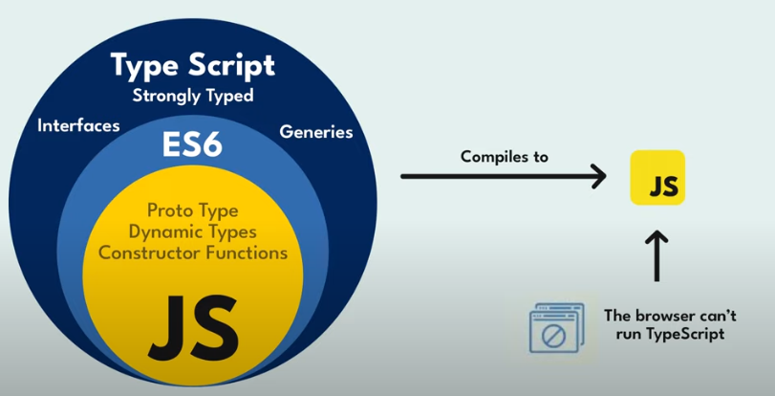
What is TypeScript

Slide 3
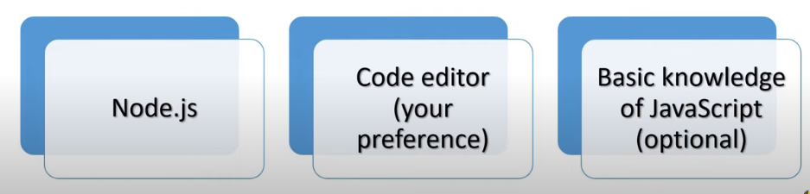

Requirement for installation
https://nodejs.org/en/
node -version or node -v
https://www.typescriptlang.org/download
npm install -g typescript
tsc -v
tsc -w

Slide 4
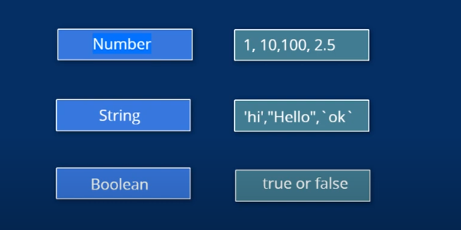
Core Types

